Slide 1
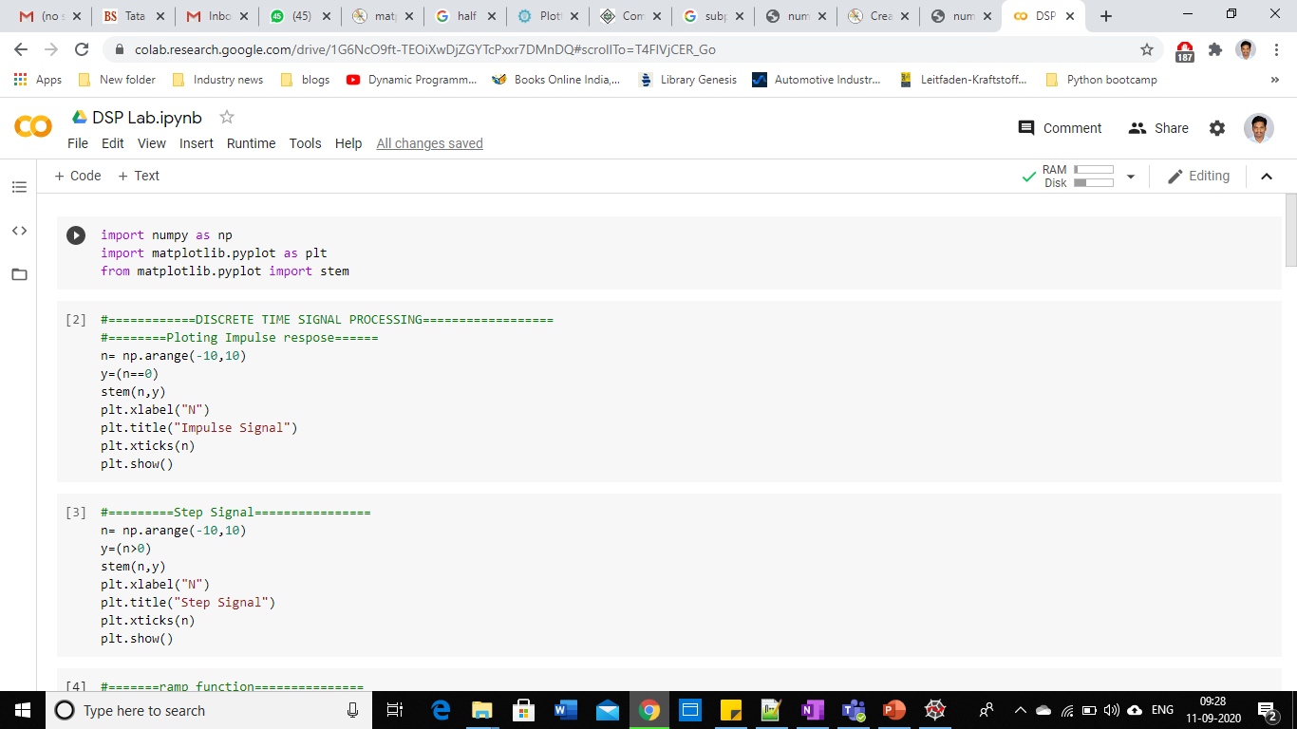
How to run the python notebook
Click in the link
https://colab.research.google.com/drive/1G6NcO9ft-TEOiXwDjZGYTcPxxr7DMnDQ?usp=sharing
After clicking the link you will see this screen

Slide 2
How to run
You will observe the PLAY button when you move the mouse to this place
Run the play button to the cell. ( the first cell is only importing necessary libraries / packages

Slide 3
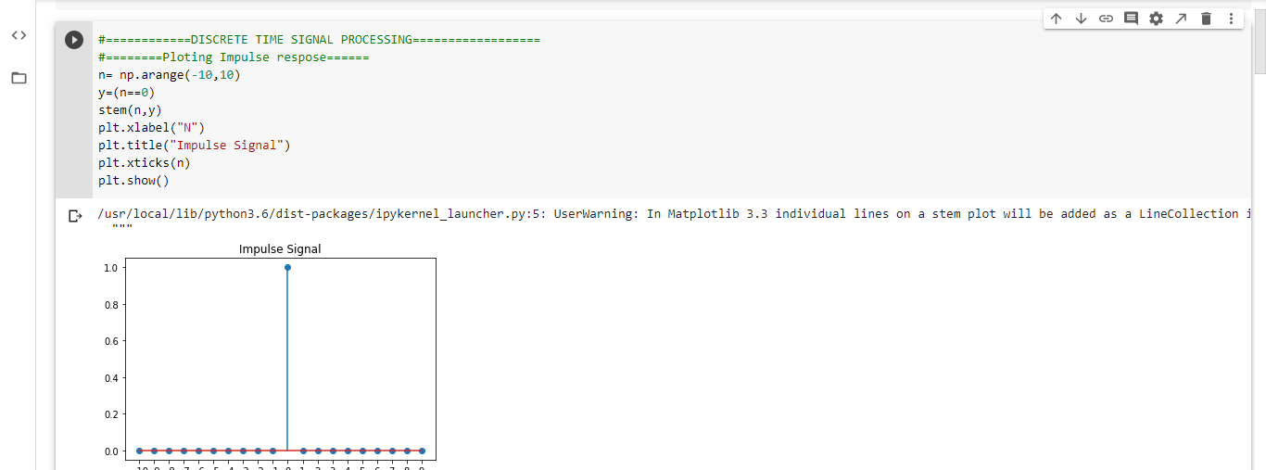
Running the cell
After we press the button , the graph/ results will appear in this place
We can close the output/graph by clicking on the prompt

